Slide 1
A Universal Turing Machine
Costas Busch - LSU

Slide 2
A limitation of Turing Machines:
Turing Machines are “hardwired”
they execute
only one program
Real Computers are re-programmable
Costas Busch - LSU

Slide 3
Solution:
Universal Turing Machine
Attributes:
Reprogrammable machine
Simulates any other Turing Machine
Costas Busch - LSU

Slide 4

Universal Turing Machine
simulates any Turing Machine
Input of Universal Turing Machine:
Description of transitions of
Input string of
Costas Busch - LSU

Slide 5
Tape 1
Three tapes
Description of
Universal
Turing
Machine
Tape 2
Tape Contents of
Tape 3
State of
Costas Busch - LSU

Slide 6
Tape 1
Description of
We describe Turing machine
as a string of symbols:
We encode as a string of symbols
Costas Busch - LSU

Slide 7








Alphabet Encoding
Symbols:
Encoding:
Costas Busch - LSU

Slide 8






State Encoding
States:
Encoding:
Head Move Encoding
Move:
Encoding:
Costas Busch - LSU

Slide 9
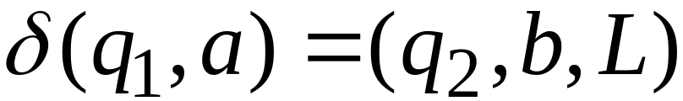
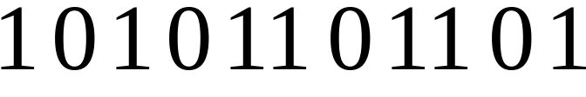
Transition Encoding
Transition:
Encoding:
separator
Costas Busch - LSU

Slide 10
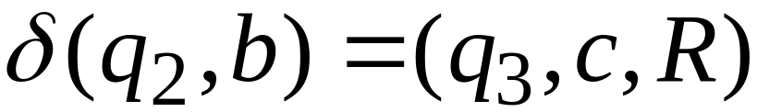

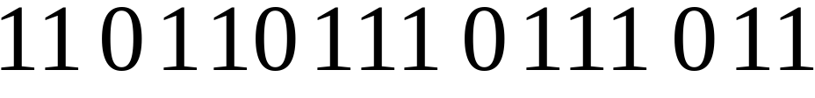
Turing Machine Encoding
Transitions:
Encoding:
separator
Costas Busch - LSU

Slide 11
Tape 1 contents of Universal Turing Machine:
binary encoding
of the simulated machine
Tape 1
Costas Busch - LSU

Slide 12
A Turing Machine is described
with a binary string of 0’s and 1’s
Therefore:
The set of Turing machines
forms a language:
each string of this language is
the binary encoding of a Turing Machine
Costas Busch - LSU

Slide 13
Language of Turing Machines
L = { 010100101,
00100100101111,
111010011110010101,
…… }
(Turing Machine 1)
(Turing Machine 2)
……
Costas Busch - LSU

Slide 14
Countable Sets
Costas Busch - LSU

Slide 15
Infinite sets are either:
Countable
or
Uncountable
Costas Busch - LSU

Slide 16
Countable set:
There is a one to one correspondence (injection)
of
elements of the set
to
Positive integers (1,2,3,…)
Every element of the set is mapped to a positive number
such that no two elements are mapped to same number
Costas Busch - LSU

Slide 17
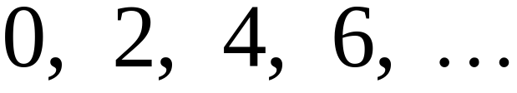
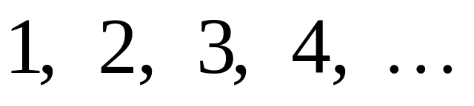

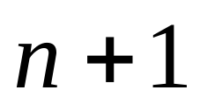
Example:
The set of even integers
is countable
Even integers:
(positive)
Correspondence:
Positive integers:
corresponds to
Costas Busch - LSU

Slide 18
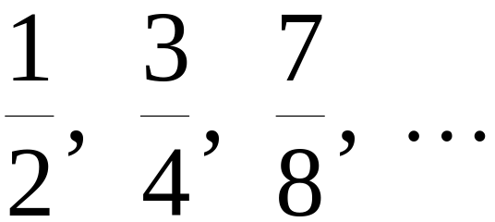
Example:
The set of rational numbers
is countable
Rational numbers:
Costas Busch - LSU

Slide 19
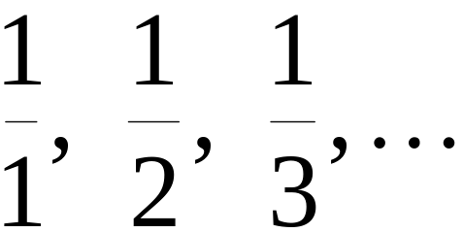
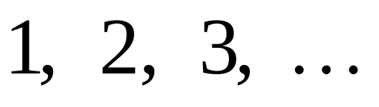
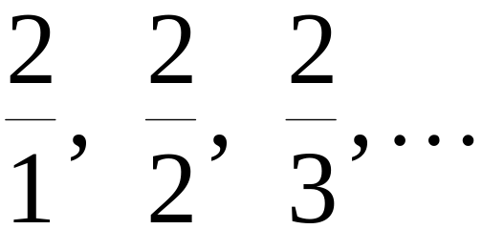
Naïve Approach
Nominator 1
Rational numbers:
Correspondence:
Positive integers:
Doesn’t work:
we will never count
numbers with nominator 2:
Costas Busch - LSU

Slide 20










Better Approach
Costas Busch - LSU

Slide 21
Costas Busch - LSU

Slide 22
Costas Busch - LSU

Slide 23
Costas Busch - LSU

Slide 24
Costas Busch - LSU

Slide 25
Costas Busch - LSU

Slide 26
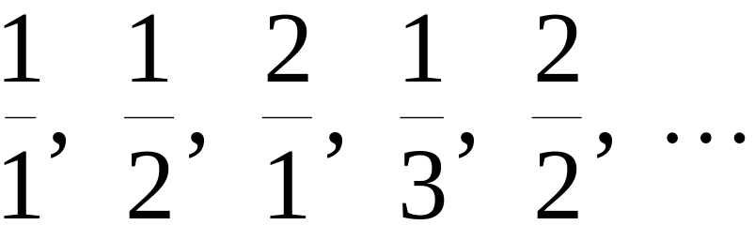
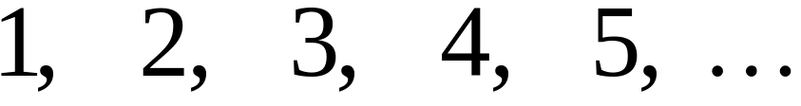
Rational Numbers:
Correspondence:
Positive Integers:
Costas Busch - LSU

Slide 27
We proved:
the set of rational numbers is countable
by describing an enumeration procedure
(enumerator)
for the correspondence to natural numbers
Costas Busch - LSU

Slide 28


Definition
Let be a set of strings (Language)
An enumerator for is a Turing Machine
that generates (prints on tape)
all the strings of one by one
and
each string is generated in finite time
Costas Busch - LSU

Slide 29
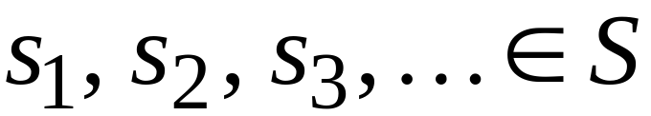
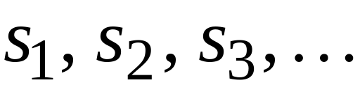

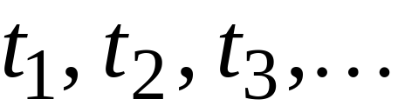
strings
Enumerator
Machine for
output
(on tape)
Finite time:
Costas Busch - LSU

Slide 30







Enumerator Machine
Configuration
Time 0
prints
Time
Costas Busch - LSU

Slide 31






prints
Time
prints
Time
Costas Busch - LSU

Slide 32
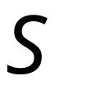
Observation:
If for a set there is an enumerator,
then the set is countable
The enumerator describes the
correspondence of to natural numbers
Costas Busch - LSU

Slide 33
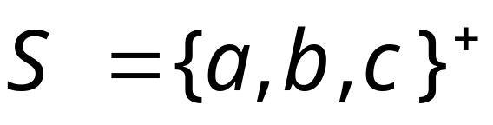

Example:
The set of strings
is countable
Approach:
We will describe an enumerator for
Costas Busch - LSU

Slide 34






Naive enumerator:
Produce the strings in lexicographic order:
Doesn’t work:
strings starting with
will never be produced
Costas Busch - LSU

Slide 35
Better procedure:
Proper Order
(Canonical Order)
1. Produce all strings of length 1
2. Produce all strings of length 2
3. Produce all strings of length 3
4. Produce all strings of length 4
……
Costas Busch - LSU

Slide 36

















length 1
Produce strings in
Proper Order:
length 2
length 3
Costas Busch - LSU

Slide 37
Theorem:
The set of all Turing Machines
is countable
Proof:
Any Turing Machine can be encoded
with a binary string of 0’s and 1’s
Find an enumeration procedure
for the set of Turing Machine strings
Costas Busch - LSU

Slide 38
Enumerator:
Repeat
1. Generate the next binary string
of 0’s and 1’s in proper order
2. Check if the string describes a
Turing Machine
if YES: print string on output tape
if NO: ignore string
Costas Busch - LSU

Slide 39





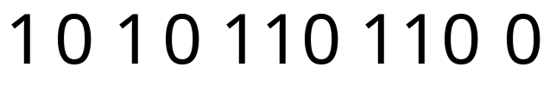

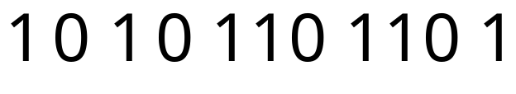
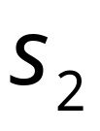
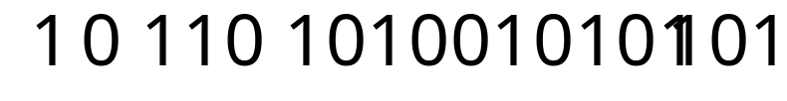
Binary strings
Turing Machines
ignore
ignore
ignore
End of Proof
Costas Busch - LSU

Slide 40
Uncountable Sets
Costas Busch - LSU

Slide 41
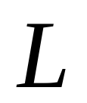
We will prove that there is a language
which is not accepted by any Turing machine
Technique:
Turing machines are countable
Languages are uncountable
(there are more languages than Turing Machines)
Costas Busch - LSU

Slide 42
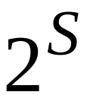
Theorem:
If is an infinite countable set, then
the powerset of is uncountable.
The powerset contains all possible subsets of
Example:
Costas Busch - LSU

Slide 43
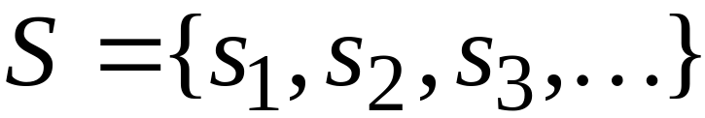
Proof:
Since is countable, we can list its
elements in some order
Elements of
Costas Busch - LSU

Slide 44
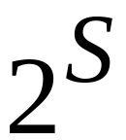

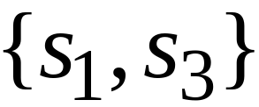
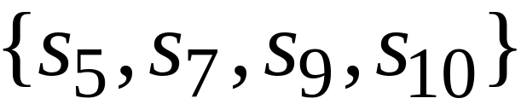
Elements of the powerset have the form:
……
They are subsets of
Costas Busch - LSU

Slide 45




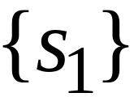

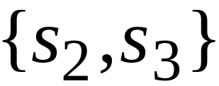
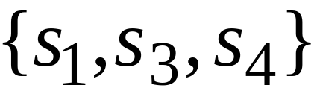
We encode each subset of
with a binary string of 0’s and 1’s
Binary encoding
Subset of
Costas Busch - LSU

Slide 46
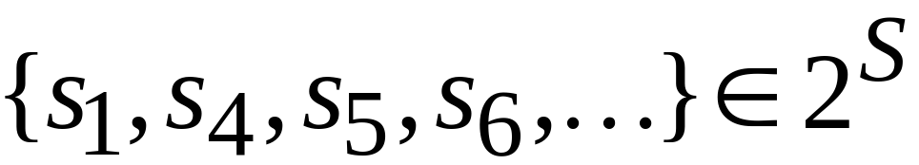
Every infinite binary string corresponds
to a subset of :
Example:
Corresponds to:
Costas Busch - LSU

Slide 47
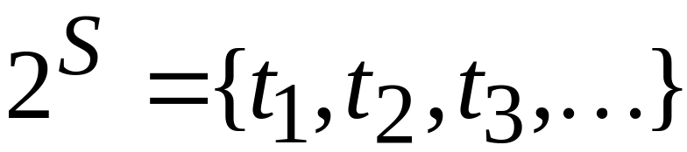
Let’s assume (for contradiction)
that the powerset is countable
Then: we can list the elements of the
powerset in some order
Subsets of
Costas Busch - LSU

Slide 48




Powerset
element
Binary encoding example
Costas Busch - LSU

Slide 49

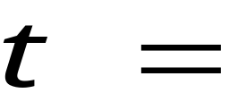
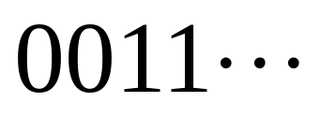
the binary string whose bits
are the complement of the diagonal
Binary string:
(birary complement of diagonal)
Costas Busch - LSU

Slide 50

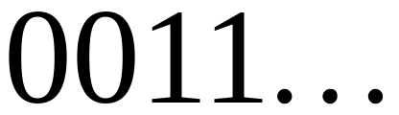
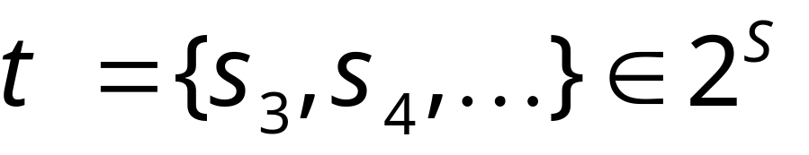
The binary string
corresponds
to a subset of :
Costas Busch - LSU

Slide 51


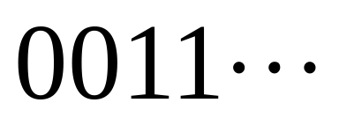
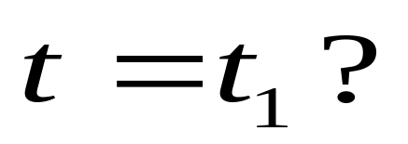
the binary string whose bits
are the complement of the diagonal
Question:
NO: differ in 1st bit
Costas Busch - LSU

Slide 52
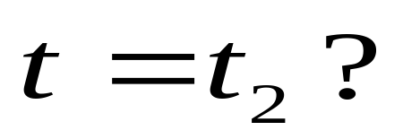
the binary string whose bits
are the complement of the diagonal
Question:
NO: differ in 2nd bit
Costas Busch - LSU

Slide 53
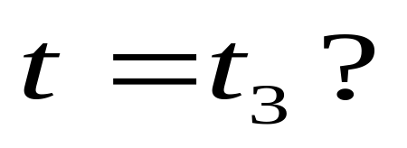
the binary string whose bits
are the complement of the diagonal
Question:
NO: differ in 3rd bit
Costas Busch - LSU

Slide 54
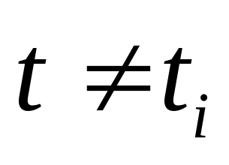

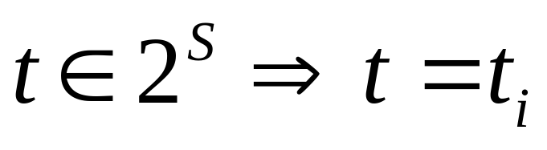
Thus: for every
since they differ in the th bit
However,
for some
Contradiction!!!
Therefore the powerset is uncountable
End of proof
Costas Busch - LSU

Slide 55
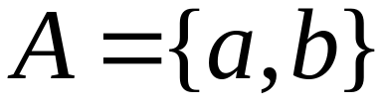
An Application: Languages
Consider Alphabet :
The set of all strings:
infinite and countable
because we can enumerate
the strings in proper order
Costas Busch - LSU

Slide 56
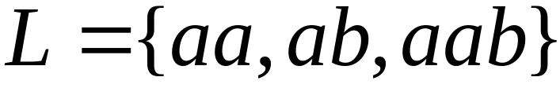
Consider Alphabet :
The set of all strings:
infinite and countable
Any language is a subset of :
Costas Busch - LSU

Slide 57
Consider Alphabet :
The set of all Strings:
infinite and countable
The powerset of contains all languages:
uncountable
Costas Busch - LSU

Slide 58
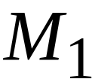
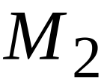
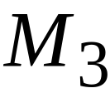



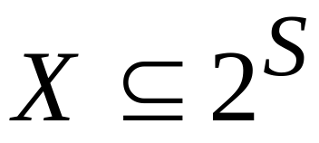
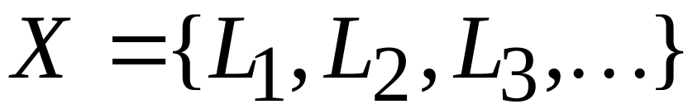

Consider Alphabet :
countable
Turing machines:
accepts
Languages accepted
By Turing Machines:
countable
Denote:
Note:
countable
Costas Busch - LSU

Slide 59



Languages accepted
by Turing machines:
countable
All possible languages:
uncountable
Therefore:
Costas Busch - LSU

Slide 60



Conclusion:
There is a language not accepted
by any Turing Machine:
Costas Busch - LSU

Slide 61

Non Turing-Acceptable Languages
Turing-Acceptable
Languages
Costas Busch - LSU

Slide 62
Note that:
is a multi-set (elements may repeat)
since a language may be accepted
by more than one Turing machine
However, if we remove the repeated elements,
the resulting set is again countable since every element
still corresponds to a positive integer
Costas Busch - LSU

